Slide 1

Weekly Update 2.6
Hongyu Dai

Slide 2
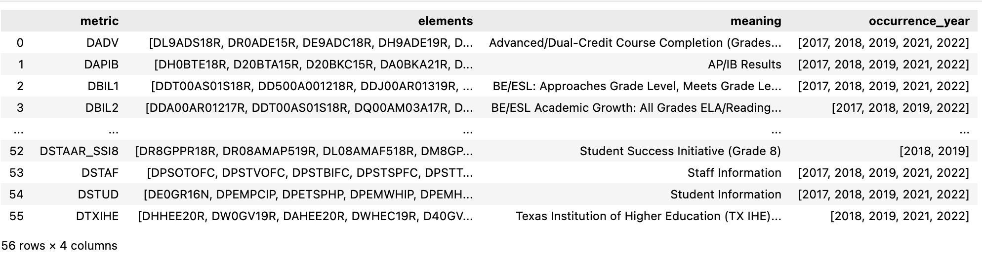
Accomplishments
Pdf to Table
Original pdf consisted of campus and district data
Manually deleted district data
Converted district pdf to csv format
TX district-level data web scraping
Used selenium to simulate the real-world process to download all data
Combined the files into one data frame/csv file according to its year
Retrieved all metrics and elements
Verified if they have the same metrics among 5 different years
Table Mapping
Provided ability to input single elements & a list of elements

Slide 3
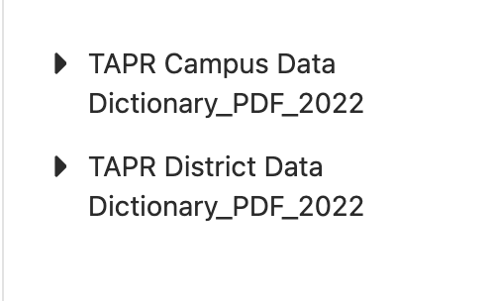
Pdf to Table
Original pdf consisted of campus and district data
Manually deleted district data
Converted district pdf to csv format

Slide 4
TX district-level data web scraping
Used selenium to simulate the real-world process to download all data
Combined the files into one data frame/csv file according to its year
Retrieved all metrics and elements
Verified if they have the same metrics among 5 different years
Develop Abbreviation CSV for Improved Comprehension of String Data

Slide 5
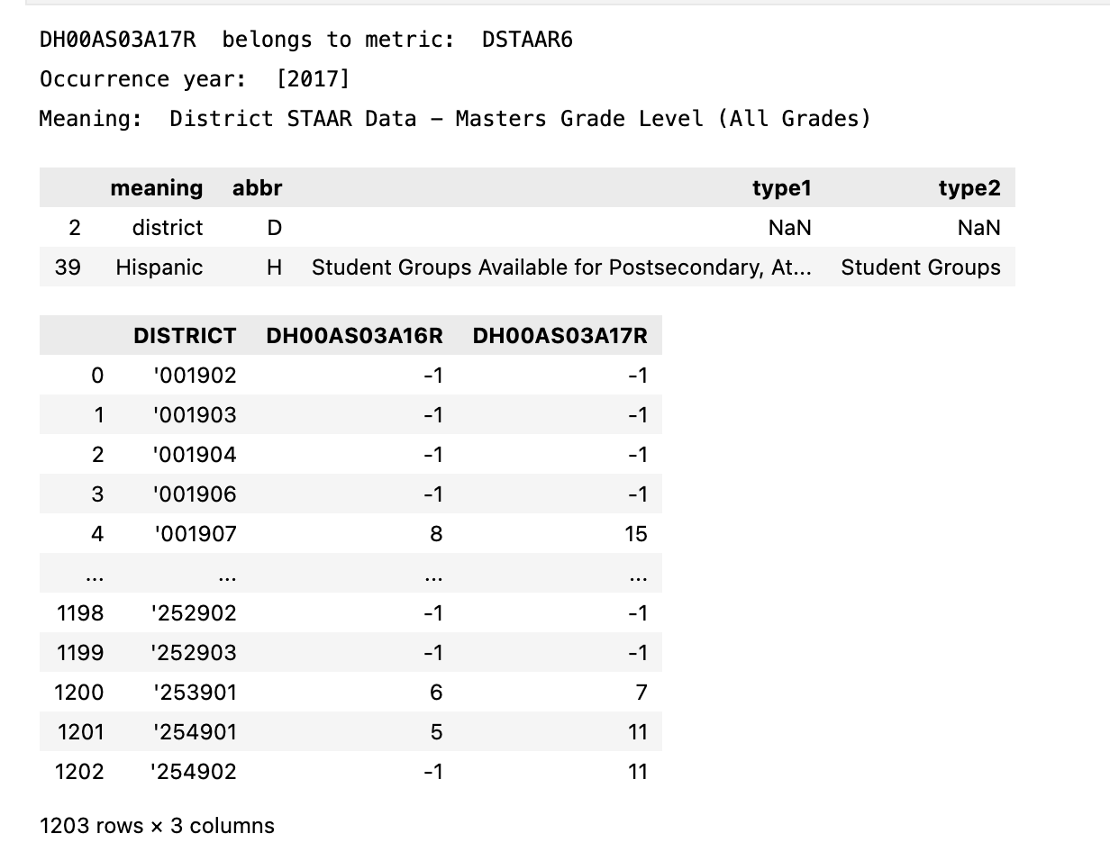
Table Mapping - Single Element
Write 2 functions to achieve
Input single element
Input list of elements
Return
A data frame with the related data in all exist year ranges.
Explanation of input string
input='DH00AS03A17R'

Slide 6
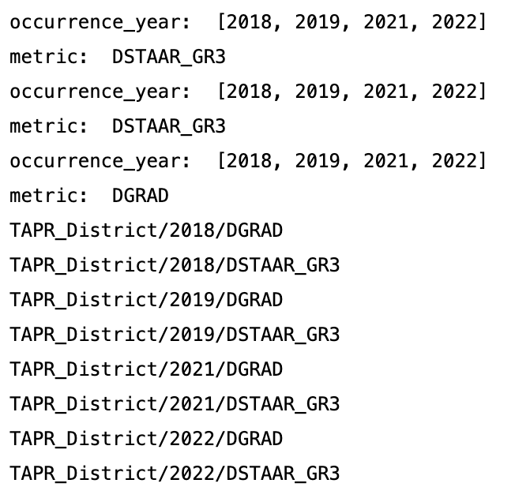
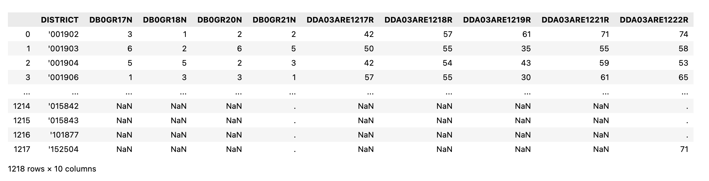
Table Mapping - List of Elements
input_list= ['DDA03ARE1219R','DDA03ARE1218R','DB0GR18N']

Slide 7
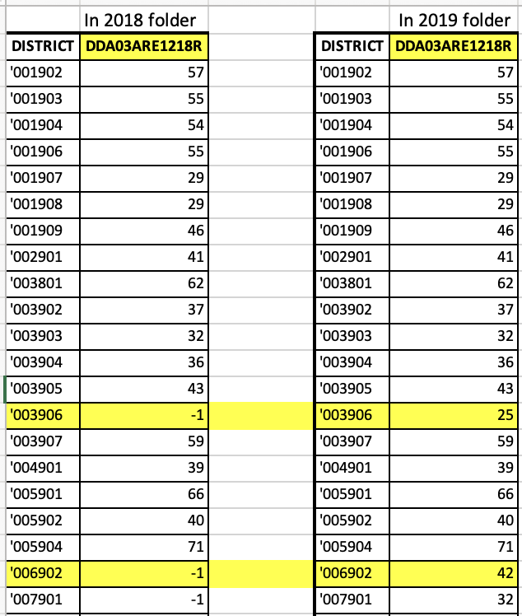
Challenges and Issues:
For duplicate result: save the one in later year folder
Should we use Table QA? How should we use it?

Slide 8
Next Steps
Get into California data
Try to apply Table QA model..?

